Slide 1
Pneumonia Detection with Weighted Voting Ensemble of CNN Models
ICAIBD 2019 | Chengdu, China
Presenter : Heewon Ko, Hyunsoo HA
Notes:
Hello, my name is Heewon Ko, and I’m the presenter of our research.

Slide 2
INDEX
01. Introduction
02. Related Work
03. Methodology
04. Experiment
05. Conclusion
Notes:
My presentation is divided into five parts.
I’m going to start with the brief introduction. And then related work, methodology, experiment and
conclusion.

Slide 3
1. Introduction
Notes:
The topic of our research is involved in one of the Kaggle competition.
The main goal of this competition is implementing an algorithm to detect a visual signal for pneumonia in medical images.
Specifically, the algorithm for the solution needs to automatically locate lung opacities on chest radiographs.

Slide 4

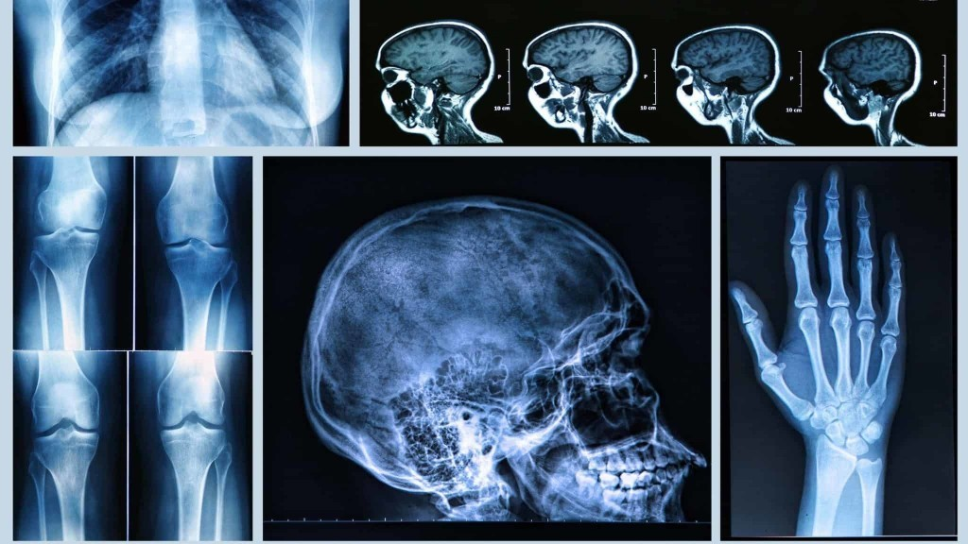
Motivation
Images from Science Times [2018]
Notes:
Since there is a considerable advance with image processing area such as classification and object
detection, Convolutional Neural Network (CNN) is frequently used in automatic diagnosis with medical
images. Moreover, an outstanding performance of CNN in a medical image such as X-rays, MRI and
CT have been demonstrated in recent research.

Slide 5
Motivation
Black = Air
White = Bone
Grey = Tissue or Fluid
Notes:
And this is also same for chest radiograph.
Let me start with briefly explaining the chest radiograph.
The black part of CXR means air, white part is bone, and grey part means tissue or fluid.

Slide 6
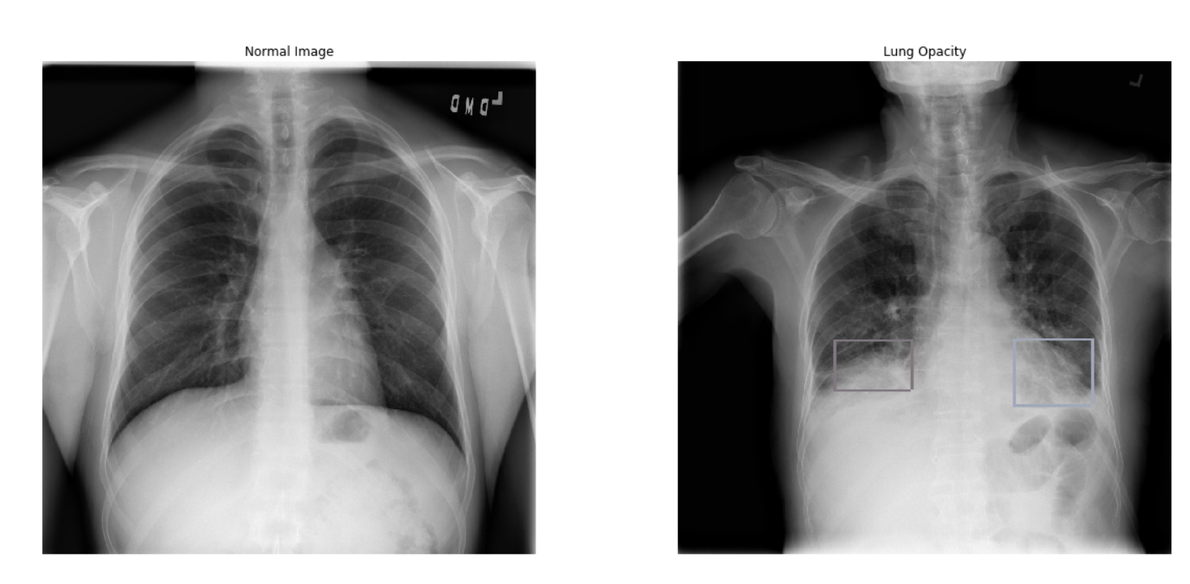
Normal vs. Pneumonia Patient
Notes:
Usually, lungs are filled with full of air.
However, when Pneumonia has occurred, the air inside the lungs is replaced by other materials such
as fluids, bacteria or immune system cells.
This phenomenon results in the area to be shown as opaque.
We call this as lung opacity.

Slide 7
Main Goals
Our main goal is to detect Lung Opacity
bounding box by object detection method on Chest X-Ray(CXR) input image
Notes:
Our main goal of the research is to detect lung opacity bounding box on chest X-Ray input image.
The primary endpoint of our project is achieving high accuracy on detecting the bounding box that has a possibility of pneumonia.

Slide 8
2. Related Work

Slide 9
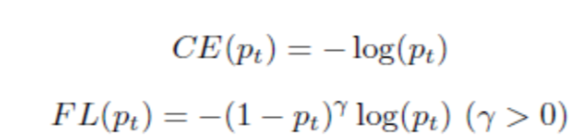
RetinaNet – Focal Loss
Notes:
One-stage detectors such as YOLO and SSD are fast and simple (by using a fixed grid of boxes in substitute for region proposals), but provide a relatively low accuracy over two-stage methods (such as Mask R-CNN).
To address this problem caused by the foreground-background class imbalance, the one-stage RetinaNet suggests focal loss.
This is a new loss function modified on standard cross entropy criterion.
This function drastically reduced the scaling factor of cross entropy loss to almost zero.
Therefore, it is able to concentrate on mis-classified examples during training and prevent learning from being overwhelmed by most negative samples.

Slide 10
RetinaNet Structure
Image from paper “Focal Loss for Dense Object Detection”, arXiv: 1708.02002
Notes:
As the RetinaNet network adopts Feature Pyramid Network (FPN) backbone on top of the ResNet architecture, it generates multi-scale feature map layers with high resolution and rich semantic information.
Additionally, the model achieves dense coverage of boxes by using anchors of 3 scales and 3 aspect ratios at each pyramid level in FPN (implying the higher potential that two-stage systems may not provide.)
Based on these factors, RetinaNet outperforms the accuracy of two-stage methods such as Faster R-CNN (as a one-stage detector).

Slide 11
Mask-RCNN Structure
Image from paper “Mask R-CNN”, arXiv:1703.06780
Notes:
Mask R-CNN, which is an extension of the previous algorithm Faster R-CNN, simultaneously detects objects and generates segmentation masks.
It is similar to Faster R-CNN from a structural point of view in that both of them consist of two stages for detection.
In the first stage, both Mask R-CNN and Faster R-CNN propose candidate object bounding boxes called region proposals using Region Proposal Network (RPN).
Subsequently, in parallel to performing bounding box classification and regression, Mask R-CNN also applies pixel-level semantic segmentation on each of candidate boxes (while Faster R-CNN only predicts the class and box offset and does not carry out image segmentation.)
(Since RoIPool [13] used in Faster R-CNN yielded low- performing of pixel-to-pixel alignment in the process of extracting feature map, Mask R-CNN proposes RoIAlign to fix the misalignment and to preserve exact spatial locations instead of RoIPool.
RoIAlign applies bilinear interpolation to calculate the pixel value on the feature map while passing through CNN, which in turn reduces the decimal error of RoIPool. It improved mask accuracy by a relative 10% to 50% and achieved top results in all tracks of the COCO suite of challenges, including instance segmentation and bounding box object detection.)

Slide 12
3. Methodology

Slide 13
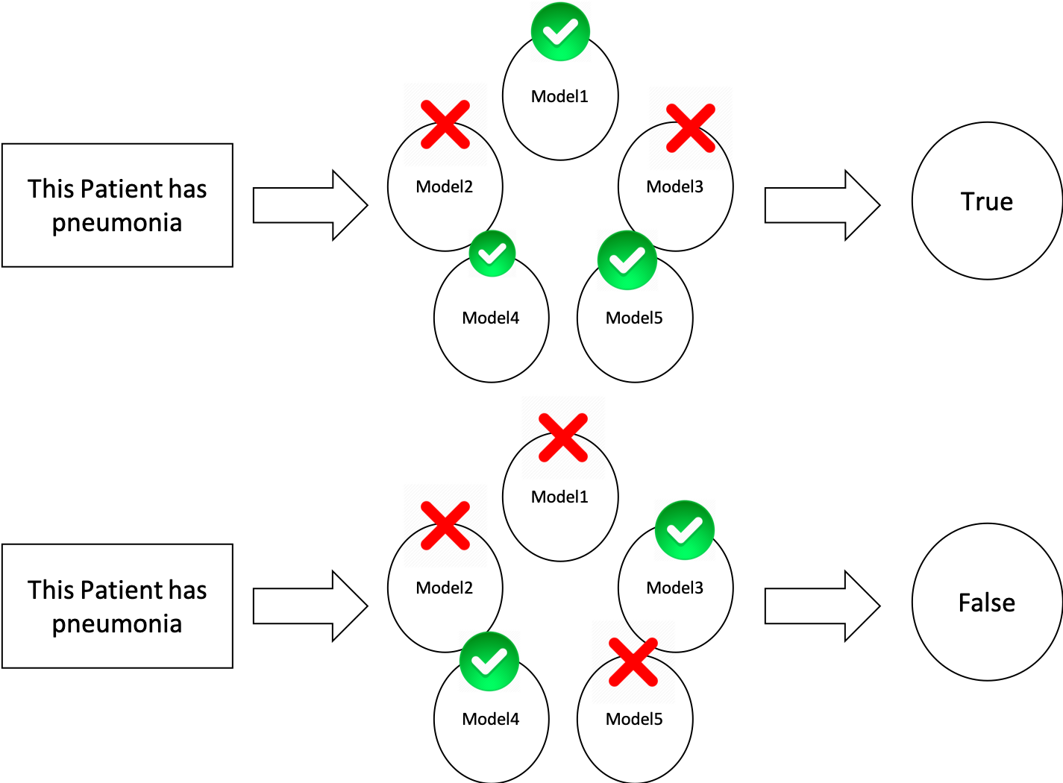
Voting Ensemble
Notes:
One of the effective ways to achieve the accuracy improvement of object detection in medical images
is to utilize ensembles of multiple models. Ensemble learning is a method for combining multiple
prediction models and using their aggregated prediction results.
(Our paper proposes a weighted majority voting ensemble based on RetinaNet and Mask R-CNN
with different weight for detecting pneumonia and describe our approach to yield high-quality
predictability on CXR.)
As you can see, every single model votes about their prediction.
For example, if we had 5 models, each prediction need at least 3 votes.

Slide 14
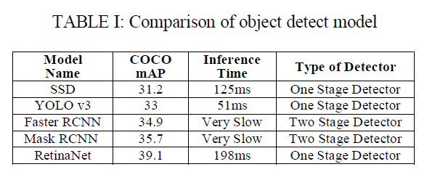
Model Comparison
Notes:
Table 1 shows comparison of various object detection models.
RetinaNet is one stage detector that obtain highest mAP score, and Mask R-CNN is the most accurate two stage detector.
Therefore, RetinaNet and Mask R-CNN were selected for ensemble learning.

Slide 15
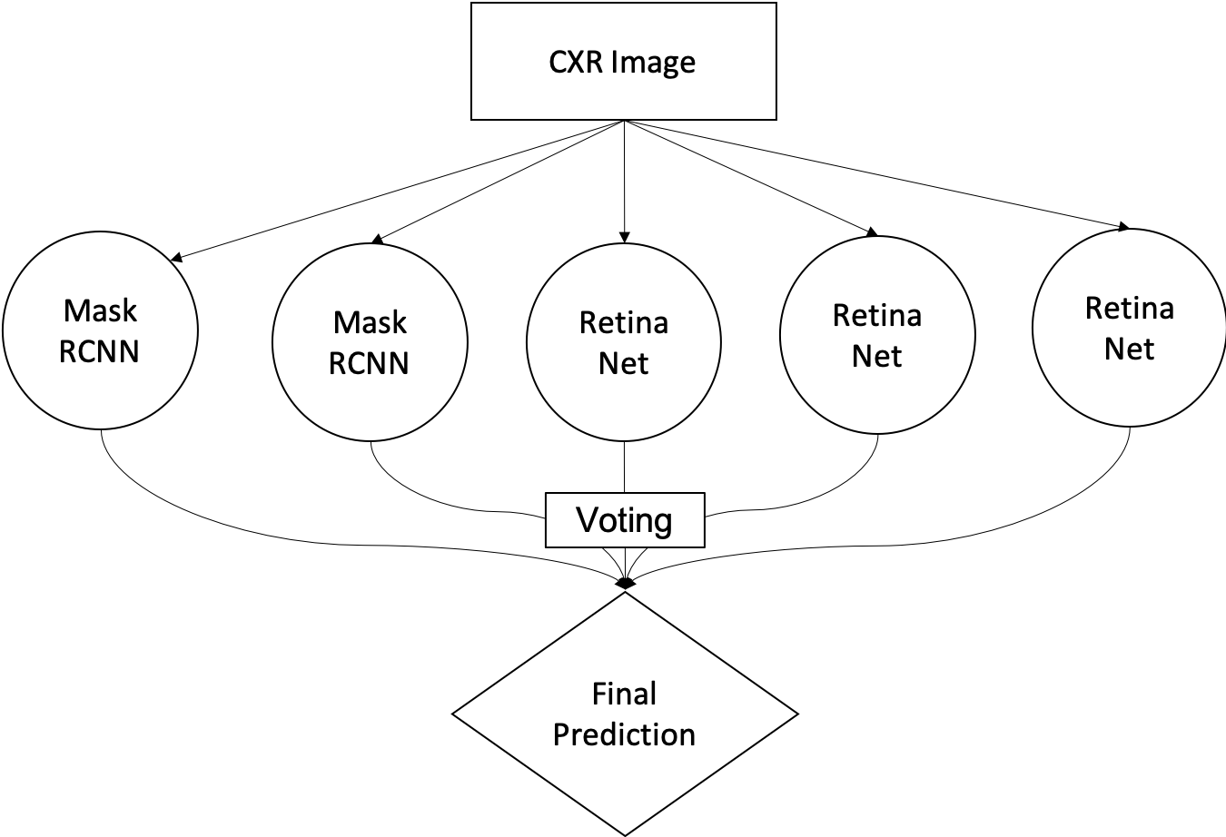
Voting Ensemble
Notes:
We selected 2 Mask R-CNN and 3 RetinaNet in the ensemble.

Slide 16
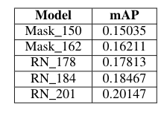
Models that used in ensemble
We selected 2 Mask RCNN and 3 RetinaNet model which obtained high mAP.
Notes:
We selected 2 of Mask R-CNN and 3 of RetinaNet model which obtained high mAP score.

Slide 17
Weighted Majority Voting Ensemble
Majority Weighted Voting Ensemble is simple.
Better model can vote more.
Notes:
Since we had quite a big gap of mAP between each models, we determined to use majority weighted voting ensemble.
It is giving different weights to each model so that better model can vote more.
Majority weighted voting was used in order to ensemble those models applied to this experiment.
The paper applied intersection over union (IoU) between bounding boxes which each of model predicted and set the IoU threshold as 0.3.
That is, if the IoU value of prediction bounding boxes exceeds the threshold value, the average coordinates of two bounding boxes (x, y-coordinates, width, and height) are considered to be in the prediction candidate group.
Then the voting threshold was set which is to determine whether the predicted bounding box is included in the final prediction.
If a number of votes for a particular prediction bounding box by each model exceed the voting threshold, the box would be considered as the final prediction.
The voting threshold depends on the number of models contained in the ensemble learning.

Slide 18
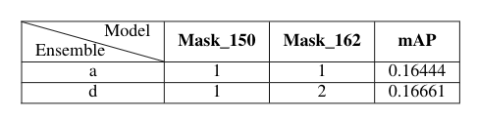
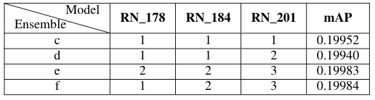
Ensemble Between Same Model
Ensemble with same model is not effective.
Sometimes it was even worse compare to the individual model.
Notes:
As you can see the score of the ensemble with Mask R-CNN and RetinaNet respectively, we came to
realize that an ensemble with same model rarely makes an improvement on performance.
Sometimes, it was even worse compare to the individual model.
For instance, RN_201 has the score of 0.201 but after ensemble, the highest score is 0.199.

Slide 19
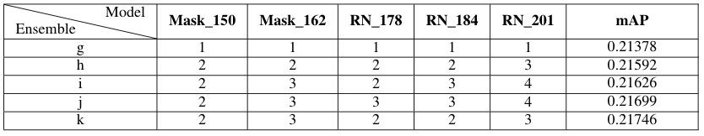
Ensemble Between Different Model
Ensemble between different model was very effective.
In democratic majority voting ensemble, mAP = 0.21378.
In Weighted majority voting ensemble, mAP = 0.21746.
This score ranked 21th / 1499 in Kaggle RSNA Competition.
Notes:
But an ensemble with different model gained a high improvement on performance of the models.
In democratic majority voting ensemble, we got the score of 0.213.
After adding weights, we got the score of 0.215.
After fine-tuning the ratio of weights given to each model, the score rise continuously with 0.216 and
finally we got the score of 0.217.
This ranked 21th place out of 1500 in Kaggle RSNA competition.

Slide 20
4. Experiments

Slide 21
Training Data
The dataset for this experiment is a subset of the NIH dataset, which is available from the Kaggle.
The total number of CXR images is 25,684 and the total number of lung opacity bounding boxes is 28,989.
The bounding boxes within an image are classified into three classes based on the presence or absence of Pneumonia.
Notes:
The dataset for this experiment is a subset of the NIH dataset, which is available from the Kaggle.
This is the total number of CXR Images, and this is the total number of lung opacity bounding boxes.
The bounding boxes within an image are classified into three classes based on the presence or absence of Pneumonia. (Our training set consists of three classes(types), such as the images with no lung opacity or not normal, normal, and lung opacity.)
1) Each of them will be labeled as ’Lung Opacity’ if bounding box contains lung opacity which is considered as pneumonia(, otherwise no pneumonia).
2) In the case of absence in pneumonia, each box is labeled as ’Normal’ if bounding box does not contain lung opacity.
3) And, ’No Opacity/Not Normal’ if bounding box does not contain lung opacity but involves any abnormalities except lung opacity.
Specifically, ’No Opacity/Not Normal’ is added with the intention of improving the accuracy of learning.
This graph shows the number of each class.
For the purpose of improving the performance of learning, data augmentation was done on each instance within a training dataset.
Data augmentation is a method of applying distortion to original dataset, therefore creating a bunch of altered copies.
The distortions (applied on each instance of our dataset) include scaling, rotating, sharpening, shearing and gaussian blur.

Slide 22
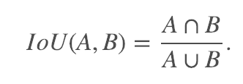
Evaluation Metric : IoU
We evaluated mean average precision(mAP) at different intersection over union (IoU) thresholds.
Notes:
The evaluation criterion of accuracy is based on mean average precision (mAP).
We evaluated mean average precision (mAP) at different intersection over union thresholds.
Intersection over union value can be obtained by using this formula. And this value indicates the ratio of the overlap between two bounding boxes.
This paper follows the rule of finding the mAP at each IoU thresholds range from 0.4 to 0.75 with a step size of 0.05 (0.4, 0.45, 0.5, 0.55, 0.6, 0.65, 0.7, 0.75).
The way to know the accuracy of a predicted bounding box is IoU. The IoU between the predicted box and the ground truth box is calculated as (3). The overlap sizes of the Predicted boxes and the ground truth boxes are divided into the total area of the two objects.
If the IoU is above the specified threshold value, it is a True Positive, otherwise a False Positive. At each threshold value t, C is measured based on all objects that are predicted when compared to True Positive (TP), False Negatives (FN), and False Positives (FP). It is calculated as (4) and it is called Precision value.

Slide 23
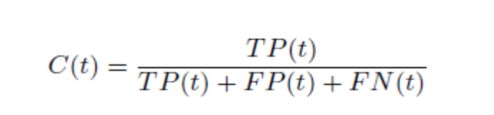
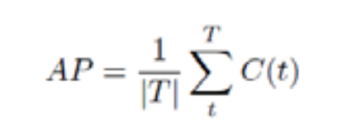
Evaluation Metric : mAP
We can get Average Precision by this formula.
TP(True Positive) : Counted when a single predicted object matches a actual object with an IoU above the threshold.
FP(False Positive) : Indicates a predicted object had no association with actual object.
FN(False Negative) : Indicates a actual object had no association with predicted object.
Notes:
In order to get mean Average Precision, we should get Average Precision first.
We can get Average Precision by this formula.
True Positive divided by the sum of True Positive, False Positive and False Negative.
The definition of True Positive, False Positive and False Negative is stated below.
AP)
While the IoU threshold of this range is calculated on one image, Average Precision (AP) is measured.
The threshold value is increased from 0.4 to 0.75 by 0.05 to find ‘hits’ and ‘misses’. AP for a single
image is calculated as the average of Precision Values at each IoU thresholds. T is the set of specific
thresholds.
mAP)
The evaluation score is the mean taken over the individual average precisions of each image in the
test dataset. Thus, all of the models are evaluated on the mAP at different IoU thresholds.

Slide 24

Experiment Environment
Both training and testing were performed on Google Cloud Platform Machine Learning Engine.
It has 39GB memory, 6 vCPUs, and NVIDIA Tesla V100 on the Google Cloud virtual machine instance.
Notes:
Both training and testing were performed on Google Cloud Platform Machine Learning Engine. It has 39GB memory, 6 vCPUs, and NVIDIA Tesla V100 on the Google Cloud virtual machine instance.

Slide 25
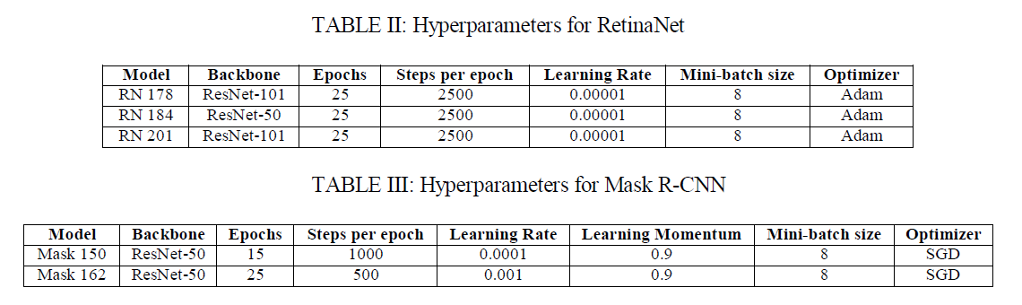
Learning parameter
Notes:
TensorFlow machine learning framework was used with those hyperparameters (to develop all the processes).
And these are the final hyperparameters we used for training.

Slide 26
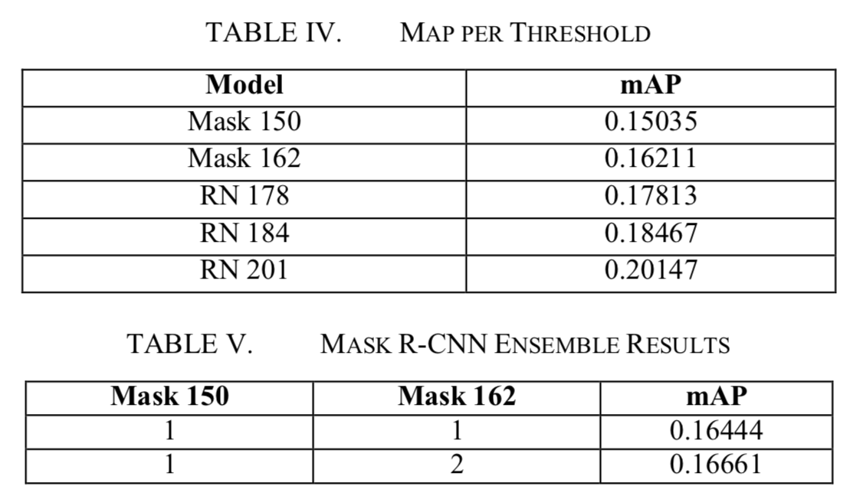
Mask R-CNN Emsemble
Our final attempt is to combine two of the Mask R-CNN models and three of the RetinaNet models handled on this experiment.
Notes:
The table IV shows the mAP of each Mask R-CNN and RetinaNet models that applied to the ensemble. Two Mask R- CNN models and three RetinaNet models were used respectively for an ensemble.
Table V shows the result of ensemble using two Mask-R- CNN models. The result of mAP using the equal weight for two Mask R-CNN models was 0.16444.
Then doubled the weight to the classifier which gained the best mAP among Mask R-CNNs.
When ensembled with Mask R-CNN only, the mAP obtained by majority weighted voting method is 0.16661.
It performed better than the majority voting without weight.

Slide 27
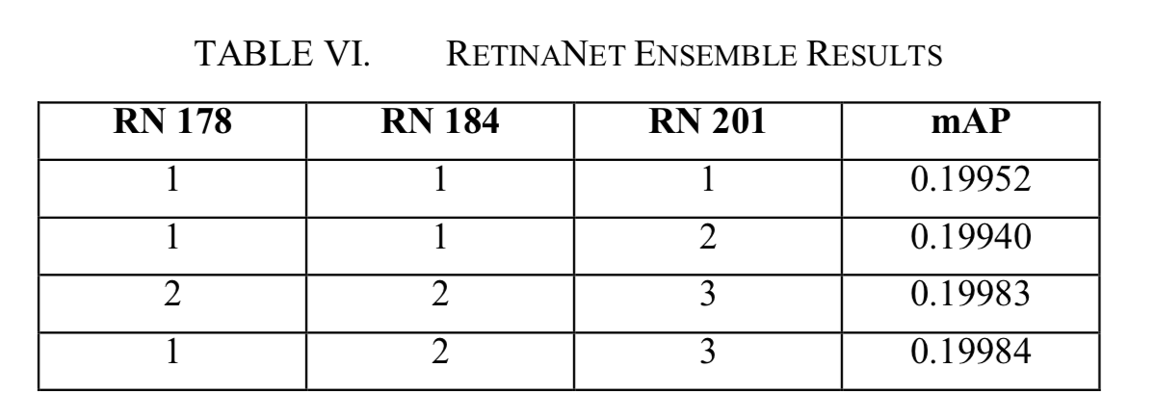
RetinaNet Emsemble
Notes:
Table VI shows the weight given to each classifier and the mAP of an ensemble using three RetinaNet models.
The result of mAP using equal weight for each models was 0.19952.
Then doubled the weight of the model with the highest mAP value.
The mAP obtained from this case is 0.19940.
Then fine- tuning was done with the ratio of the weights given to each model in more detail by 2:2:3, 1:2:3 and obtained the mAP of 0.19983, 0.19984.
These results demonstrate that combining multiple models should not always be better performed than the best individual classifier in the ensemble.

Slide 28
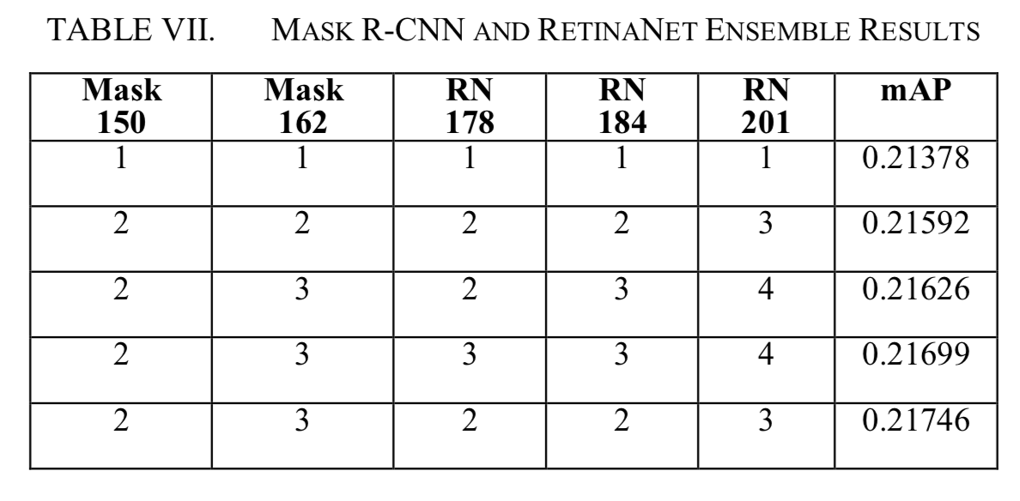
Mask R-CNN and RetinaNet Emsemble
Notes:
Our final attempt is to combine two of the Mask R-CNN models and three of the RetinaNet models
handled on this experiment.
Table VII shows the mAPs of each experiment conducted by giving different weight ratios to multiple
classifiers. The mAP is 0.21378 when only the majority voting method is applied. According to the two
previous ensemble experiments, it is indicated that applying relatively more weights to the model of
the highest mAP helps to improve the mAP. Thus, the highest weight was given to the model of RN
201.
As a result of the experiment, the value of mAP increased to 0.21592. Then we adjusted the ratio of
weights given to each of the models in more detail and gained the best mAP of 0.21746. The process
of combining the results of these different CNN architectures in this way allows each model to capture
complementary information and, consequently, to increase the completeness of the overall prediction.
Arguably this integrated set of prediction improves mAP and reduces the total error rate compared to
applying each separate model.

Slide 29
5. Conclusion
Notes:
Before I finish, I’d like to briefly recap what I’ve talked about so far.

Slide 30
Result of prediction
Notes:
This is our experiment result, which is the coordinate values and confidence of lung opacity on predicted bounding boxes for each patient. We demonstrated the efficiency of our approach by combining multiple classifiers with majority weighted voting ensemble method.

Slide 31
Conclusion
In this work, we propose multiple ensemble approaches based on Mask R-CNN and RetinaNet to detect lung opacity in CXR.
The suitable ratio of weights given to each classifier played an important role in our competition score.
By fine-tuning the ratio of the weights given to each classifier, we finally achieved a mAP of 0.21746 with a late submission in Kaggle RSNA Pneumonia Detection Challenge with ranked as 21th place of 1499 in the competition private leaderboard.
Notes:
In this work, we proposed multiple ensemble approaches based on Mask R-CNN and RetinaNet to
detect lung opacity in CXR.
(Various attempts to ensemble Mask R-CNN and RetinaNet models were done respectively, gaining
slightly higher mAP compared to adopting only a top-performing classifier (involved in the ensemble).
(Then combining several Mask R-CNN and RetinaNet models was done for the ensemble.))
The point I’d like to emphasize is that suitable ratio of weights given to each classifier played an
important role in our competition score.
By fine-tuning the ratio of the weights given to each classifier, the mAP was increased to 0.21746
with a late submission in Kaggle RSNA Pneumonia Detection Challenge, approximately could be
ranked as a 21st place out of 1499 in the competition private leaderboard.

Slide 32
Thank you
Notes:
Thanks for listening to my presentation.

